Slide 1
Replacement AutoEncoder
April 19th 2018
A Privacy-Preserving Algorithm for Sensory Data Analysis
Hamed Haddadi
h.haddadi@imperial.ac.uk
A joint work with:
Mohammad Malekzadeh and Richard G. Clegg

Slide 2
Context
Location (~50m)
Microphone
Location (~3m)
Microphone
Gyroscope
Accelerometer
Barometer
Magnetometer
Thermometer
Proximity
Ambient Light
Humidity
1973
2018
Notes:
This slide is here for introducing the context and motivate the problem.
Smart devices measure more and more data every generation.

Slide 3
Agenda
Motivation
Sensory Data and Sensitive Information
Solution:
Inference-Specific Transformation
Replacement Autoencoder
Results:
Utility vs. Privacy
Information Leak
Future Directions:
Analytical and Practical Requirements
Q & A
Notes:
You can ignore this slide if it is boring ☺

Slide 4
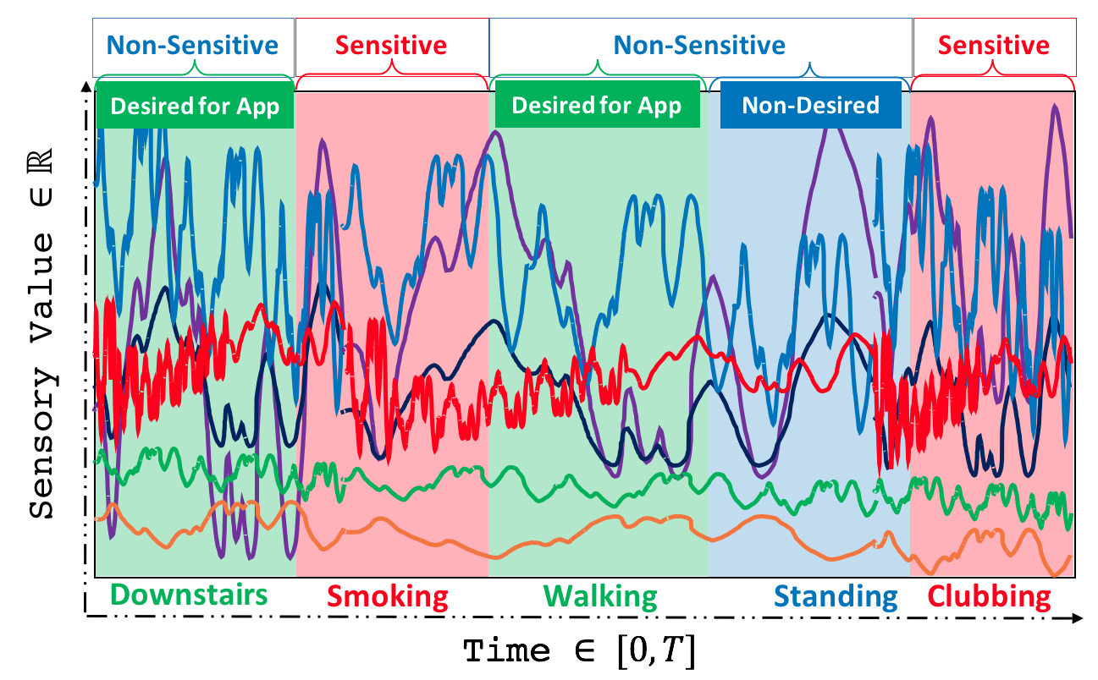
Temporal Inferences on Sensory Data
Inference-Specific Transformation
Notes:
We can translate each section of a senor time-series to an inference that can be sensitive/nonsensitive ….
This slide and the next one for introducing the prolem.

Slide 5
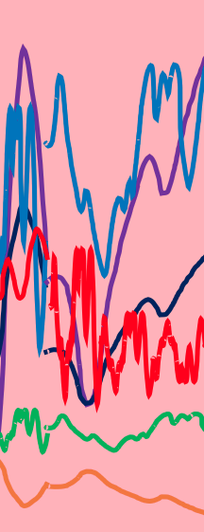
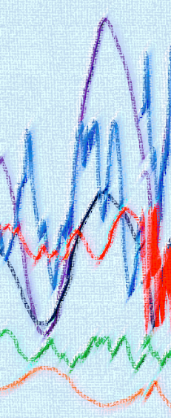
Real-Time Transformation based on Corresponding State
Raw Data
Transformed Data
Inference-Specific
Transformation
Notes:
We explain the goal of the paper. We should make it clear that we want to do this real-time.

Slide 6
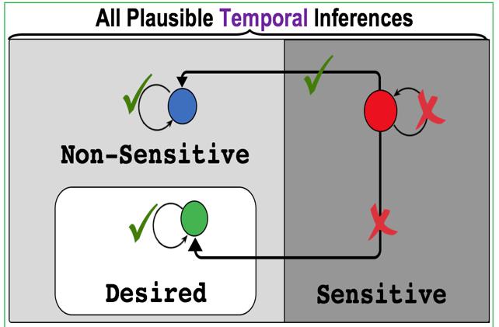
Replacing Sensitive Sections with Non-Desired ones
Notes:
Here with this diagram we explain that the goal is to replace sensitive sections to a non-desired non sensitive instance.
If we transform sensitive to desired it harms utility. Other Non Sensitives and Desired section in the state space should be kept exactly same.

Slide 7
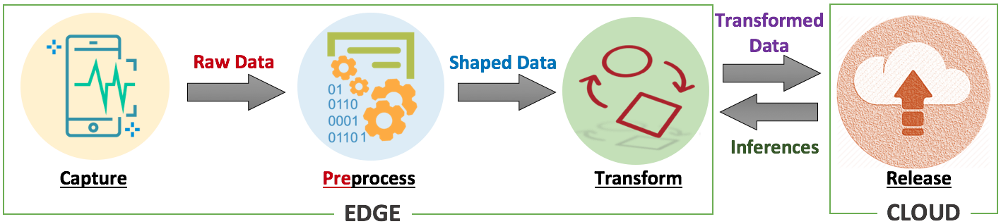

We propose a Hybrid Architecture
We apply a privacy-preserving transformation on raw data at the Edge
Then send transformed data to the Cloud for performing deep analysis and receive the promised services.
Notes:
We say that why we choose a Hybrid architecture:
We do transformation on the edge and give data to the cloud to give us the promised servies.

Slide 8
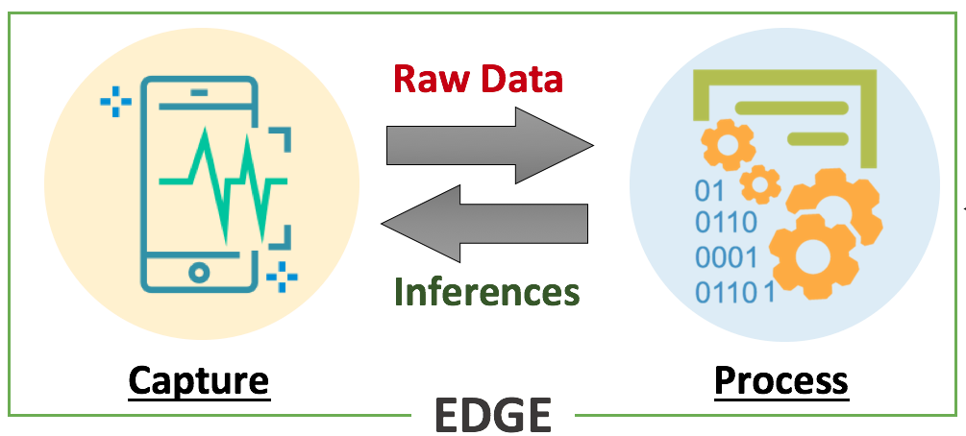
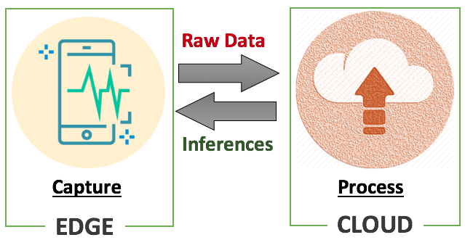
Privacy-Utility Tradeoff
I. Edge-Based
II. Cloud-Based
Perfect Privacy vs. Week Utility
Week Privacy vs. Perfect Utility
Good Privacy
and
Good Utility
III. Hybrid
Notes:
Here we say what is the other approaches and why both of the aren’t as good as Hybrid one.
Utility is completely preserved
when user-aware non-sensitive information can be accurately inferred by the applications.
Privacy is somehow violated:
when any unwanted personal information can be inferred from the released data.

Slide 9
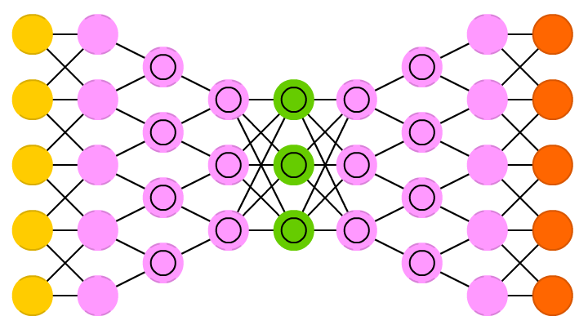
The High-Level Architecture of the Solution
Replacement AutoEncoder (RAE)
Notes:
Here we start from top and introduce the framework.
We see how we can utilize deep feature learning by autoencoders to replace sensitive intervals with non-sensitive-wise data.
Here Should explain these for the rest of presentation:
* black-listed Inferences: sensitive information that users wish to keep private and should not be revealed to third parties. The black-listed inferences are sufficiently sensitive that the user would wish to prevent inference that they have undertaken any activities within this set even if the third party did not know which specific inference.
* white-listed Inferences: desired information that users gain utility from sharing with third parties services.
* gray-listed Inferences: non-sensitive information that is neutral. It is not useful to the user that this information is detected by third parties yet it is not important for the user to hide it. It may include data that cannot be mapped to a known behavior.

Slide 10
Why Autoencoders?
To Discover the most salient features of the data.
A bottleneck: Middle Layer Size << data dimension. e.g. : 50 << 1000
Force to discover the essence of the data in order to reconstruct it.

Slide 11
Key Idea: Remove Black Feature While Decoding Data
Encode raw data, x, into a new representation, y.
Decode y into a privatized version, z, using only whites and greys features which have been learnt by the model.

Slide 12
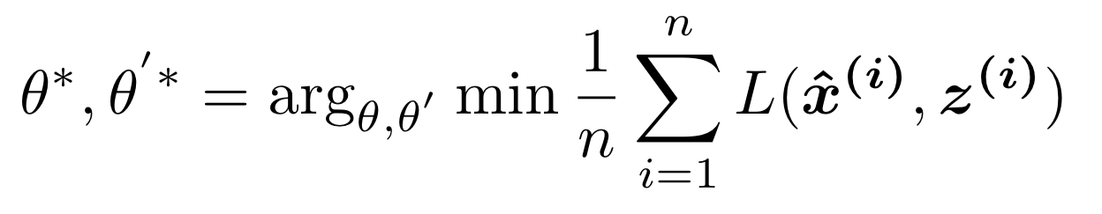
Training the RAE
Notes:
In classic autoencoder we try to minimize the reconstruction loss ( mean squared error) between X and Z.
Here we use x as input same as classic one. Encode X into Y, BUT for loss function we use X-hat and Z.
X-hat is the replaced version of X.
As we see, X-hat differs with X just for blacklisted data samples.
That means, if in X is a training dataset with 1000 samples: W,G,B.
If we have 200 B samples and 500 G samples, then we randomly replace these 200 Bs with 200 of those 500 Gs and name this new dataset X-hat.
I hope it’s clear :D

Slide 13
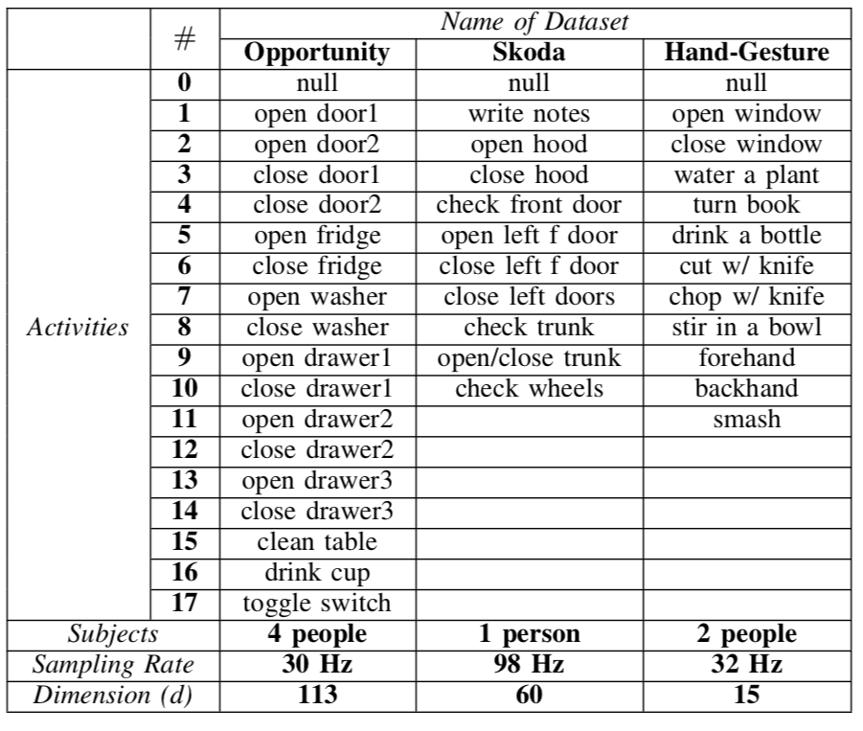
A Real-World Case Study
Activity Recognition
Three datasets of Sensor Data generated by wearable devices.

Slide 14
Experimental Setup
RAE : A 7-layers Deep Autoencoder
Activity Recognizer: A Deep Convolutional Autoencoder
We implemented the state-of-the-art for activity recognition using sensory data^{[1]}
[1] J. Yang, M. N. Nguyen, P. P. San, X. Li, and S. Krishnaswamy, “Deep convolutional neural networks on multichannel time series for human activity recognition.” in IJCAI, 2015, pp. 3995–4001.

Slide 15
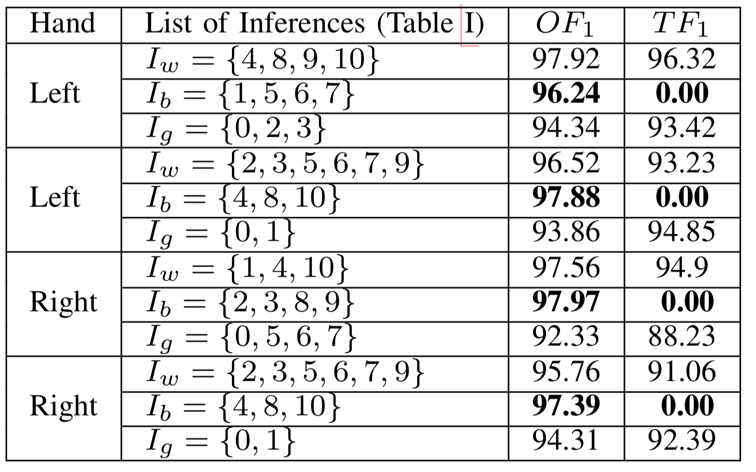
Skoda Dataset : F1-Score for Activity Recognition
Original
Transformed
White-Listed
Black-Listed
Gray-Listed
White-Listed
Black-Listed
Gray-Listed
White-Listed
Black-Listed
Gray-Listed
White-Listed
Black-Listed
Gray-Listed
Notes:
Skoda Dataset contains sensor data collected from both LEFT and RIGHT hand of the user.
From Wearable Sensors.

Slide 16
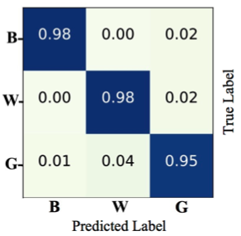
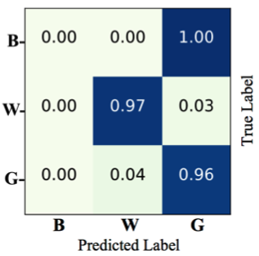
Skoda Dataset : Confusion Matrix
Original Data
Transformed Data
Notes:
Here the point is replacement doesn’t hurt utility of whitelisted.

Slide 17
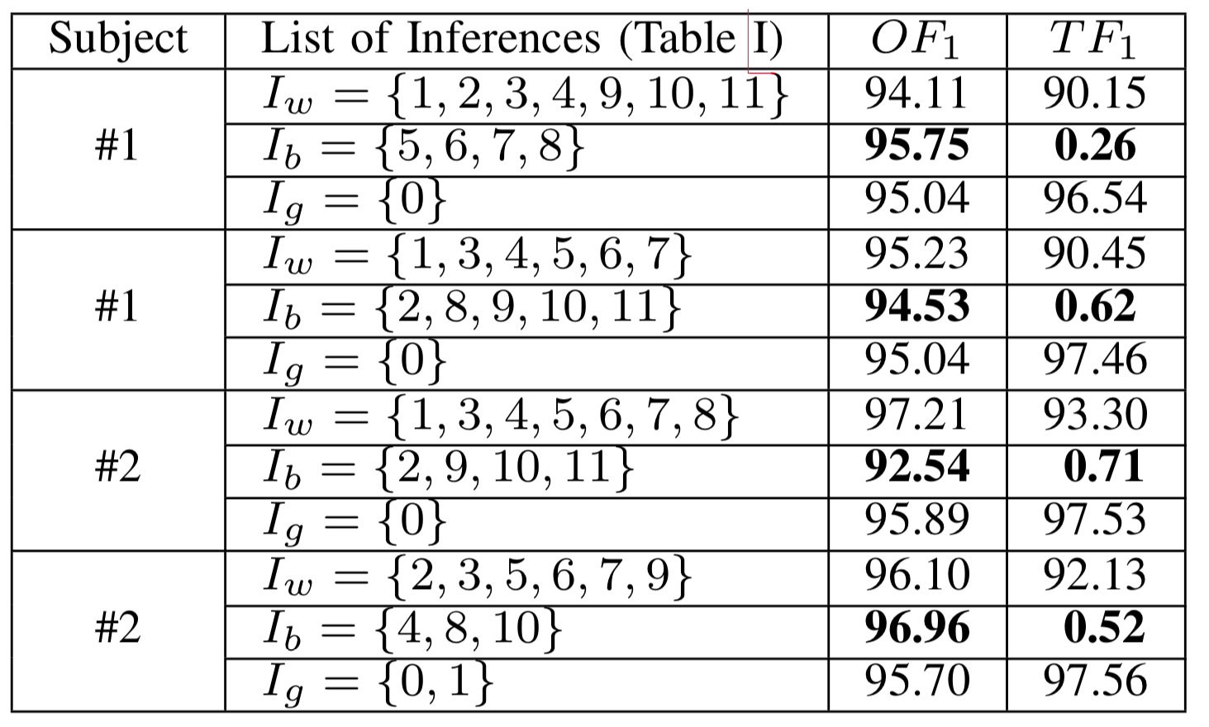
Hand-Gesture Dataset : F1-Score
Original
Transformed
White-Listed
Black-Listed
Gray-Listed
White-Listed
Black-Listed
Gray-Listed
White-Listed
Black-Listed
Gray-Listed
White-Listed
Black-Listed
Gray-Listed
Notes:
Two Data subjects. Wearable Again.

Slide 18
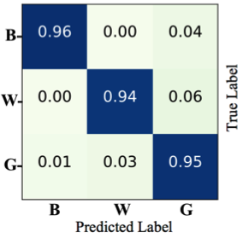
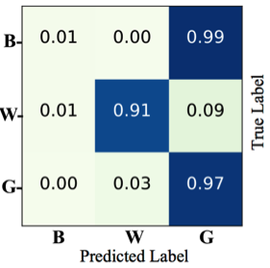
Hand-Gesture : Confusion Matrix
Original Data
Transformed Data
Notes:
Here the point is replacement doesn’t hurt utility of whitelisted.

Slide 19
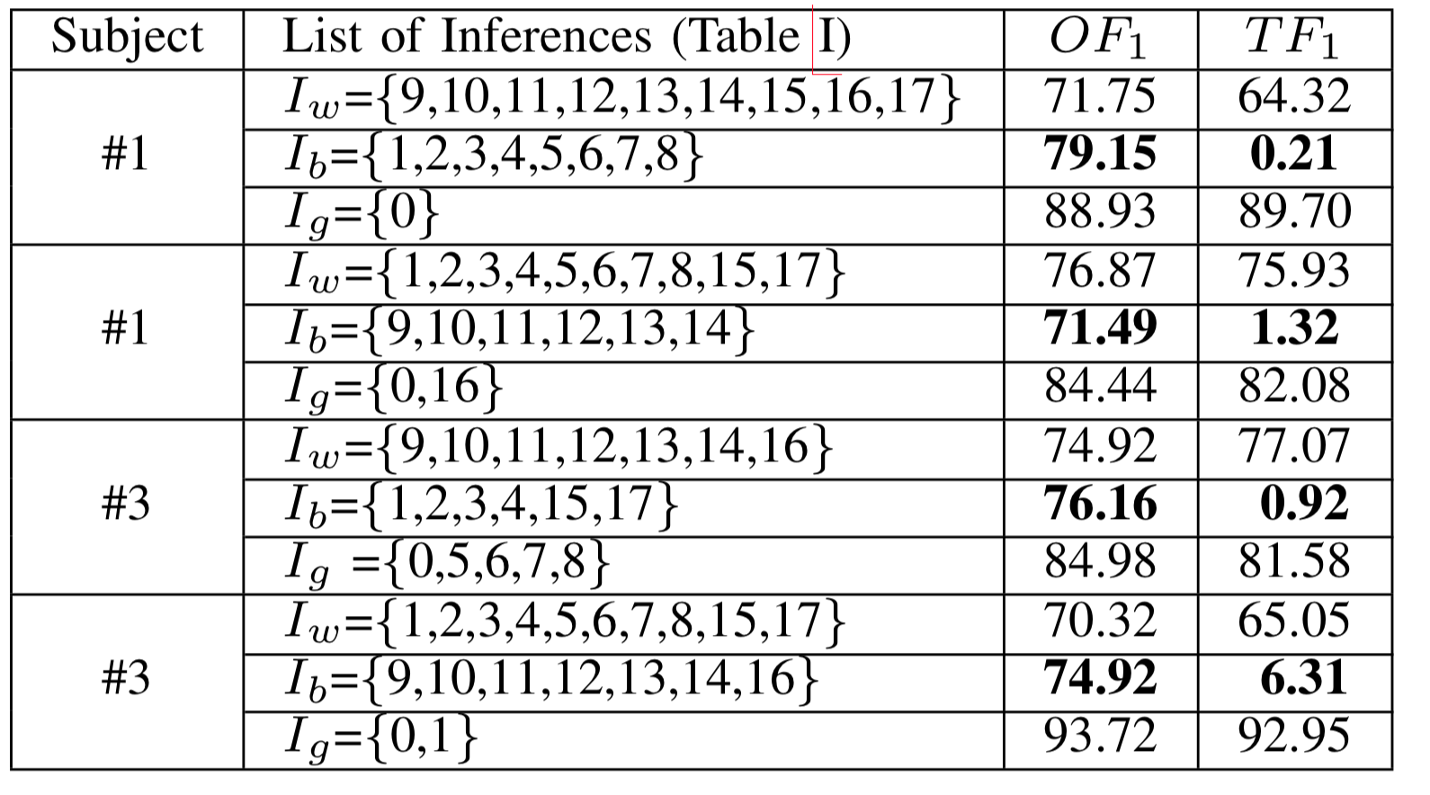
Opportunity Dataset: F1-Score
Original
Transformed
White-Listed
Black-Listed
Gray-Listed
White-Listed
Black-Listed
Gray-Listed
White-Listed
Black-Listed
Gray-Listed
White-Listed
Black-Listed
Gray-Listed

Slide 20
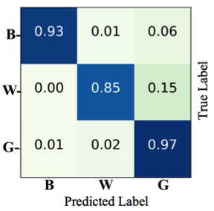
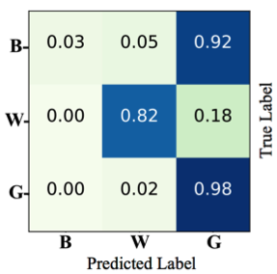
Opportunity : Confusion Matrix
Original Data
Transformed Data
Notes:
Here the point is replacement doesn’t hurt utility of whitelisted.

Slide 21
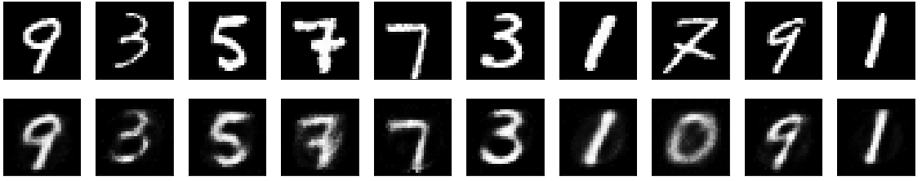
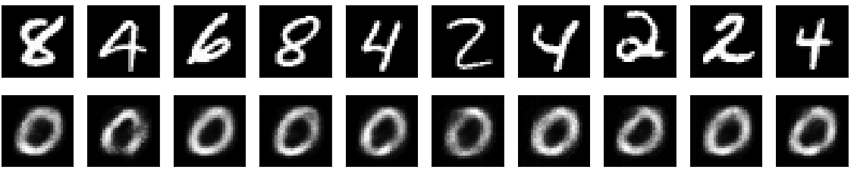
Visualization: An MNIST example
White-Listed
Original Data
Transformed Data
Digit 0 is a Gray-Listed data
Black-Listed
Original Data
Transformed Data
Notes:
we consider 0 as a kind of non-sensitive inference (gray-listed),
other even numbers (2, 4, 6, 8) as a set of sensitive inferences (black-listed),
and all of the odd numbers (1, 3, 5, 7, 9) as desired information

Slide 22
Visualization: t-SNE
Original Data
Transformed Data
Notes:
t-Distributed Stochastic Neighbor Embedding (t-SNE)
t-SNE is a technique for dimensionality reduction and a well known strategy for visualizing similarity relationships, between different classes in the dataset, in high-dimensional data
Images show the feature space relationships among different classes of activities for Skoda dataset. Regarding the scatter plots depicted in Figure 9, black-listed data points in original time-series (left) have their own structures and clearly separable from other classes. But, in the transformed version of time-series (right) all of the black-listed data points have been moved into another area of feature-space which is more closely related to gray-listed data points. They also lose their recognizable patterns and all of them mapped to almost the same area of the feature space. On the other hand, it maintains particular patterns of white-listed data points, thus causes no harm to the recognition accuracy of desired activities. Note that in this example, we reduce the dimensionality from 1800-d to just 2-d, which leads to huge information loss.

Slide 23
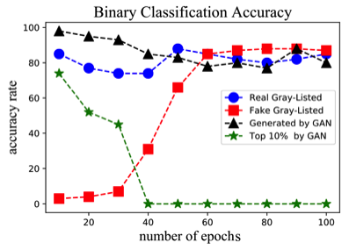
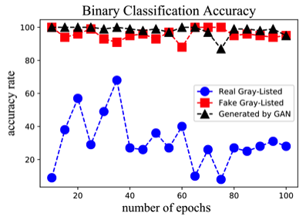
Threat Model : Using GANs to detect Replaced intervals
When Adversaries have access
To user Original Data
When Adversaries DON’T have access
To user Original Data
Notes:
I suggest to read Section VI of the paper to be clear about this slide. It’s hard for me to summarize it.
BTW, The point is: When we don’t have access to user data ( which is not irrational) GAN is not good ( Right Figure)
When they have access, they can detect. But not recognize. They just know somethings sensitive has happened but don’t know which kind.

Slide 24
Conclusion
RAE:
A hybrid architecture for locally transforming sensor data on edge devices.
Inference-Specific Transformation:
Privacy-preserving data reconstruction based on learned features correspond to different inferences.
Take Home
Encode data into a feature set, then replace sensitive information with non-sensitive not-desired features in the reconstruction (decoding) phase.

Slide 25
Future Directions
How we can provide a statistical guarantee (probabilistic bound) for sensitive information which can still be inferred from the transformed data?
Differential Privacy : Composition Theorem?
Mutual Information : Joint Distributions?
Correlation among repeated measurement:
little by little information leakage
What is the Complexity / Cost of the solution for running on Edge devices?

Slide 26
Thank You!
Replacement AutoEncoder: A Privacy-Preserving Algorithm for Sensory Data Analysis
Link to the Paper Repository: bit.ly/rae-iotdi
https://haddadi.github.io/
h.haddadi@imperial.ac.uk
@realhamed
Hamed Haddadi
Imperial College London

